Slide 1
MALIGNANT COMMENT CLASSIFIER
John Tojo
Data Science Intern

Slide 2
Overview
Introduction
Problem Statement
Exploratory Data Analysis (EDA)
Observations from graphs
Data cleaning
Model Selection
Conclusion
Future Work

Slide 3
Introduction
In the past few years its seen that the cases related to social media hatred have increased exponentially. The social media is turning into a dark venomous pit for people now a days. Online hate is the result of difference in opinion, race, religion, occupation, nationality etc. In social media the people spreading or involved in such kind of activities uses filthy languages, aggression, images etc. to offend and gravely hurt the person on the other side. This is one of the major concerns now. The result of such activities can be dangerous. It gives mental trauma to the victims making their lives miserable. People who are not well aware of mental health online hate or cyber bullying become life threatening for them. Such cases are also at rise. It is also taking its toll on religions. Each and every day we can see an incident of fighting between people of different communities or religions due to offensive social media posts. Online hate, described as abusive language, aggression, cyberbullying, hatefulness, insults, personal attacks, provocation, racism, sexism, threats, or toxicity has been identified as a major threat on online social media platforms. These kinds of activities must be checked for a better future.

Slide 4
Problem Statement
The proliferation of social media enables people to express their opinions widely online. However, at the same time, this has resulted in the emergence of conflict and hate, making online environments uninviting for users. Although researchers have found that hate is a problem across multiple platforms, there is a lack of models for online hate detection.
Online hate, described as abusive language, aggression, cyberbullying, hatefulness and many others has been identified as a major threat on online social media platforms. Social media platforms are the most prominent grounds for such toxic behaviour.
There has been a remarkable increase in the cases of cyberbullying and trolls on various social media platforms. Many celebrities and influences are facing backlashes from people and have to come across hateful and offensive comments. This can take a toll on anyone and affect them mentally leading to depression, mental illness, self-hatred and suicidal thoughts.
Internet comments are bastions of hatred and vitriol. While online anonymity has provided a new outlet for aggression and hate speech, machine learning can be used to fight it. The problem we sought to solve was the tagging of internet comments that are aggressive towards other users.
Our goal is to build a prototype of online hate and abuse comment classifier which can used to classify hate and offensive comments so that it can be controlled and restricted from spreading hatred and cyberbullying

Slide 5
DATA SOURCES AND THEIR FORMATS
The data was provided by FlipRobo in CSV format. After loading the training dataset into Jupyter Notebook using Pandas and it can be seen that there are eight columns named as:
Malignant: It is the Label column, which includes values 0 and 1, denoting if the comment is malignant or not.
Highly Malignant: It denotes comments that are highly malignant and hurtful, which includes values 0 and 1
Rude: It denotes comments that are very rude and offensive, which includes values 0 and 1
Threat: It contains indication of the comments that are giving any threat to someone, which includes values 0 and 1
Abuse: It is for comments that are abusive in nature, which includes values 0 and 1
Loathe: It describes the comments which are hateful and loathing in nature, which includes values 0 and 1
Id and comment, where comment has text

Slide 6
Exploratory Data Analysis (EDA)
Step 1
Check for nulls, dtypes of the columns
Step 3 :
comparison is done on the comments before and after cleaning to see the most frequent words present for positive and negative comments
Word cloud is also used
Step2 :
counting the no of positive and negative comments present in each columns and storing it into a data frame and later representing it in a bar chart
Recursion limit was increased in order to run the loop
The loop is used to clean the text and stemming method is used

Slide 7
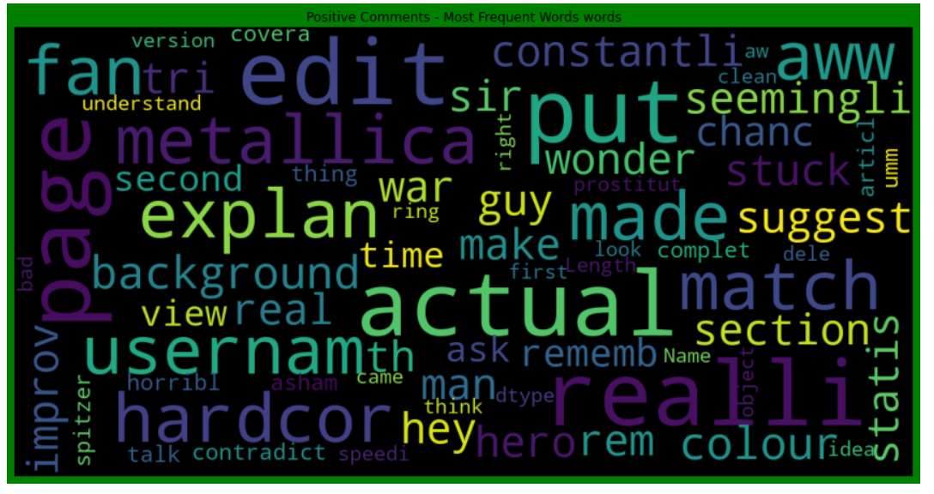
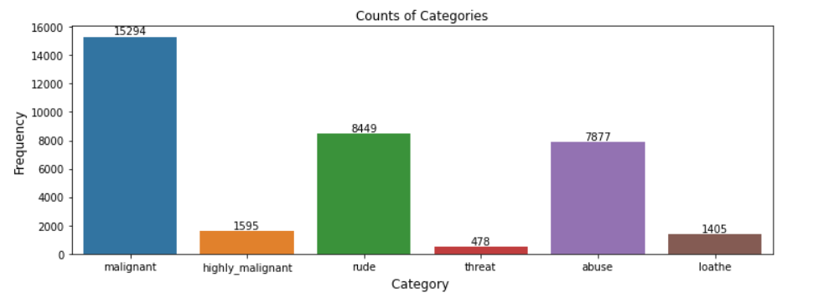
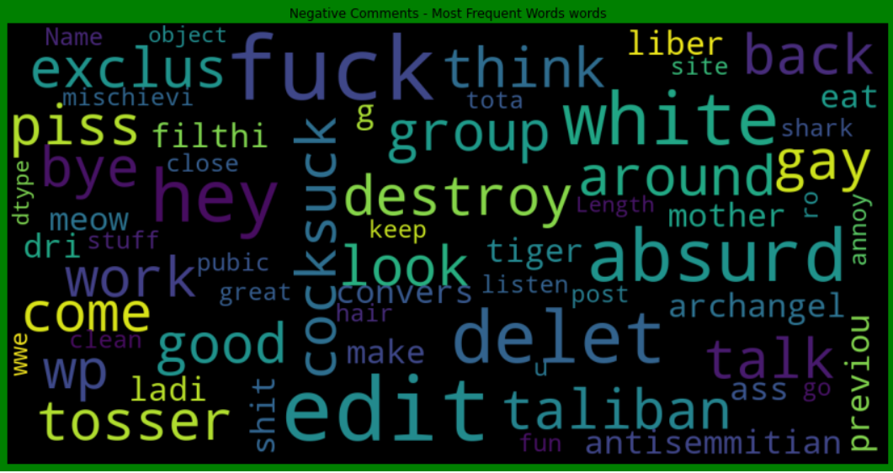
Visualization
Fig2: showing word cloud for positive comments
Fig1: it can be seen that among negative comments the most common type was malignant followed by rude
Fig3: showing word cloud for negative comments

Slide 8
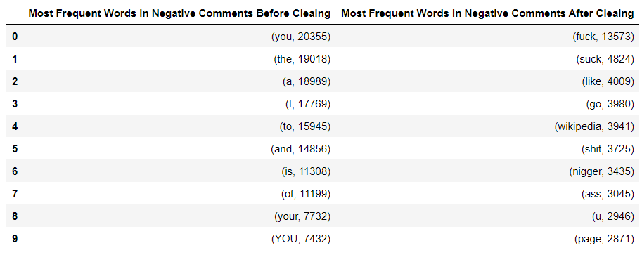
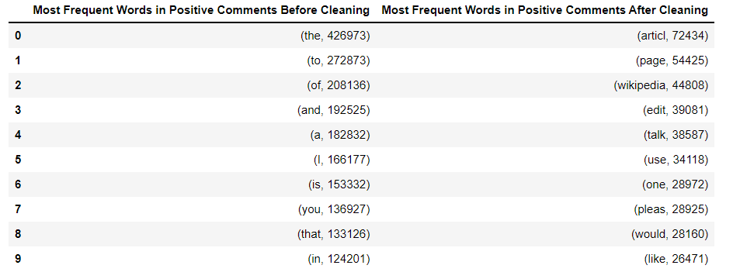
Visualization
Table2: showing the frequency of positive words before and after cleaning
Table1: showing the frequency of negative words before and after cleaning

Slide 9
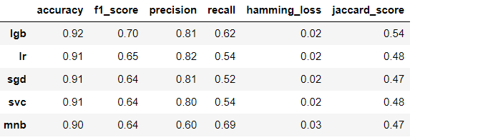
Model Selection
The problem was classification problem as the target variables would take value 0 or 1
There were 6 target variables, OneVsRestClassifier was used
The different models used were as follows:
LinearSVC
LogisticRegression(solver='lbfgs')
MultinomialNB
LGBMClassifier
SGDClassifier
The parameters used to determine the best models
were as follows:
accuracy
precision
recall
jaccard score
hamming_loss
It can be seen that the best model was lgb
highest accuracy, precision, recall, jaccard score
least hamming_loss

Slide 10
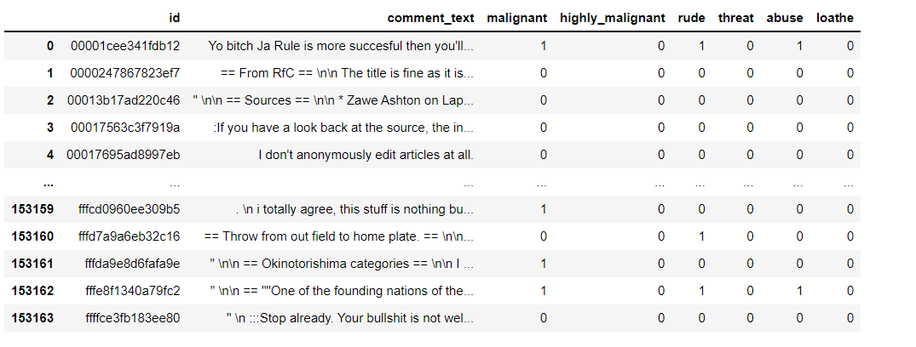
Predictions
The data on which the prediction were to be done underwent the same process as train dataset
The predictions were made and then stored into a dataframe x_test

Slide 11
Conclusion
machine learning algorithms to classify the comments
visualization has helped in understanding most frequently used words for positive and negative comments

Slide 12


